Slide 1
TOPIC : How to create a website using wordpress
By : HARISH H KULKARNI

Slide 2
What is website?
A website is a collection of web page(document that are accessed through the internet) ,which contains specific information about a person or a product or a company

Slide 3
ADVANTAGES OF WEBSITE
Easy Access to New coustumer .
Easy to use and update.
Improve productivity.
Educate your Customers.
Expand your market.
Extend your local reach. Etc..

Slide 4
Disadvantages of website
It may be difficult for researchers to locate.
Because it is not “published” the site may be disregarded as inaccurate.
The information on the site may not be reliable.
It is difficult to search the target
The site may go down or the computer may crash.

Slide 5
Why we need a website for our business ?
Credibility
Marketing online possible
Target to new customer
Passive Income Opportunities
Improve Your customer Service

Slide 6

Worried About Coding ???

Slide 7
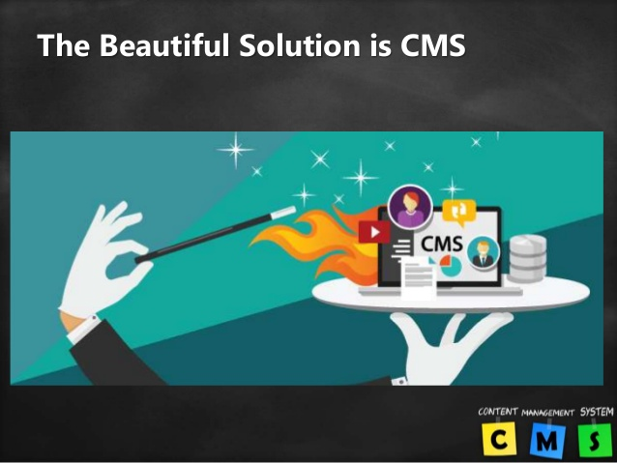

Slide 8
What is CMS??
Def: CMS is the WEB application that provides capabilities for multiple users with different permission level to manage web pages without coding knowledge.
A CMS provides the some web pages editing
Create
Edit
Publish etc...

Slide 9
Popular CMS present in Market
DRUPAL
Released in 2001
WORDPRESS
Released in 2003
JOOMAL
Released in 2005

Slide 10
Which works for what ??
DRUPAL :The most difficult,but also the most popular. It requires a familiar understanding of HTML,CSS & PHP.
WORDPRESS: Best choice for beginners because of it’s easy to ues, it works for small to medium sized websites , smaller e-commerce stores.
JOOMLA: Great for e-commerce or social networking website ,but requires a basic understanding of technical skills.

Slide 11
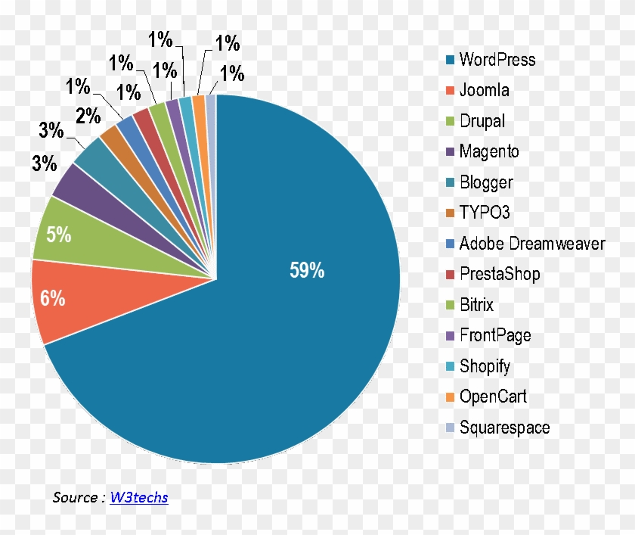
Wordpress Market Share

Slide 12
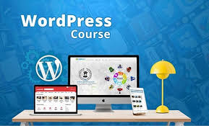

Slide 13
What is WordPress ?
Wordpress is an online , open source website creation tool written in PHP. But in non-geek speak, it’s probably the easiest & most powerful blogging & website content management system (CMS) in existence today

Slide 14
WordPress Features:
It’s Free
User Friendly
Easy to Install
Easy to Customise
Lots of Free Themes
High Security

Slide 15
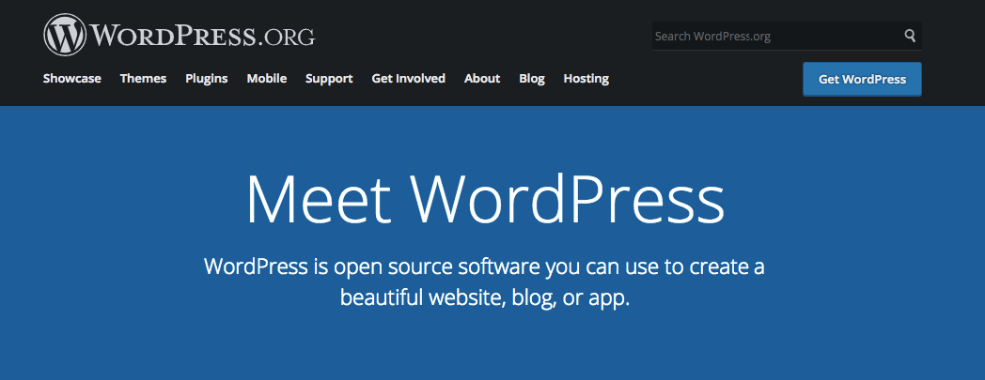
Steps to create a website
Step 1: Choose WordPress as your website platform

Slide 16

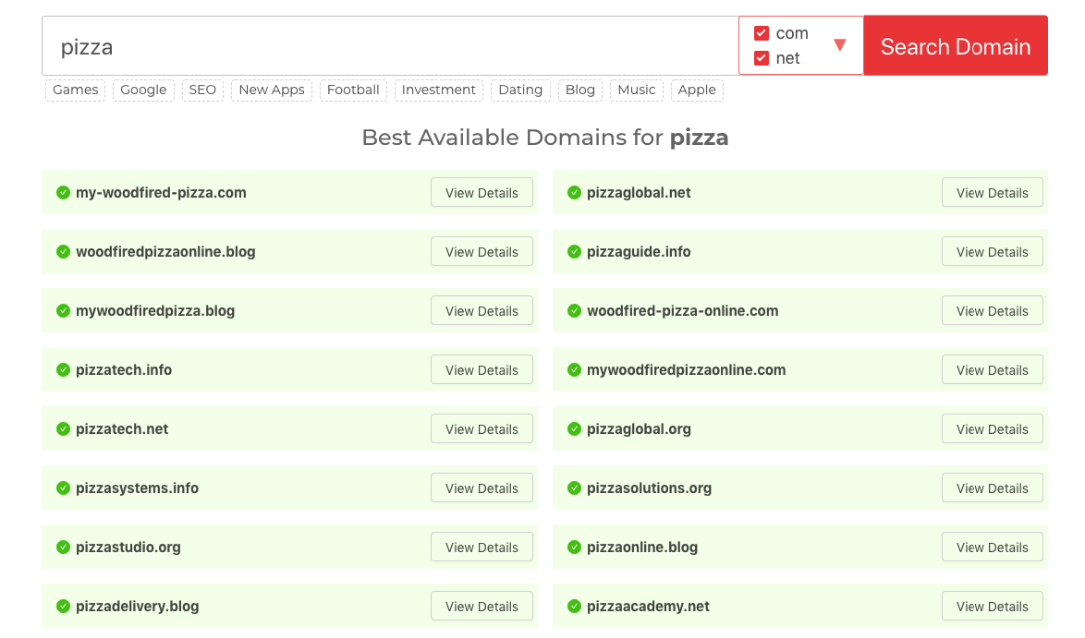
Step 2 :pick a name for your website , by a domain & hosting

Slide 17
Step 3: Get familiar with the Wordpress UI

Slide 18
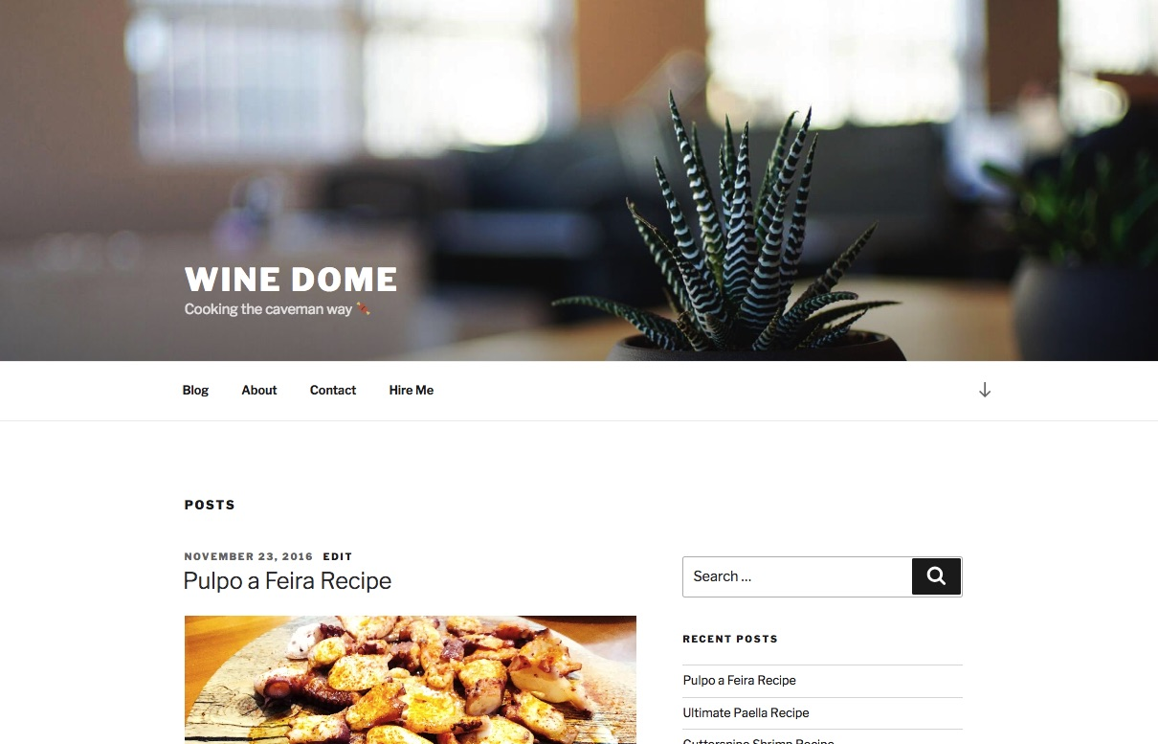

Step 4 :Pick a theme or design for your website

Slide 19
Step 5 : Get plugins to extend your website’s abilities.
Step 6 : create basic pages.
Step 7 : consider starting a blog.

Slide 20
Step 8: Adjust your site navigation
Menus

Slide 21
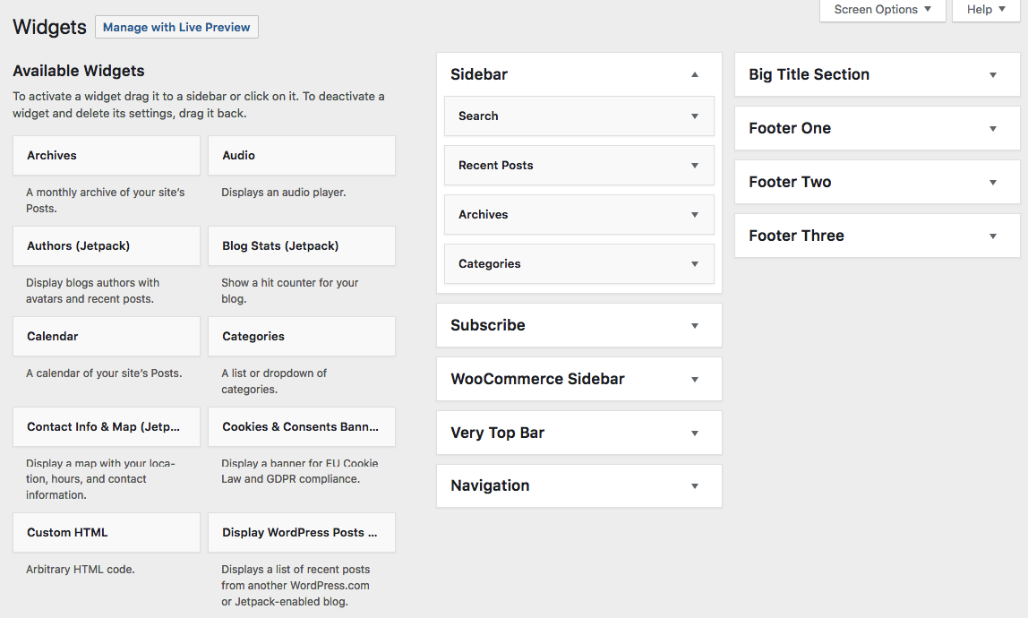
2 : Widgets

Slide 22
CONCLUSION:
That’s it! You’ve learnt how to create a website!
Thus Creating a website with Wordpress as your platform is the most budget-friendly.

Slide 23
THANK YOU

